Slide 1
Application of Moodle Analytics
LearnOnline Manager
Arshad Hussanee
^{(CRICOS) #00212K}

Slide 2
Data Warehouse
Moodle
Data Warehouse
Student/Staff
Email Notifications
Student/Staff
Dashboard
Grades to Student
Management System
^{(CRICOS) #00212K}

Slide 3
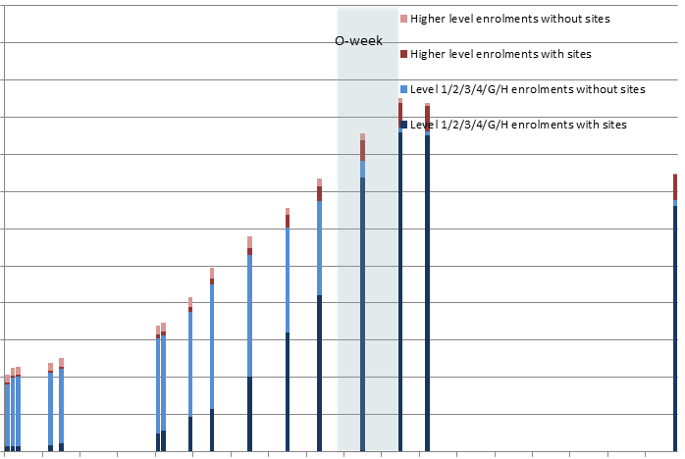
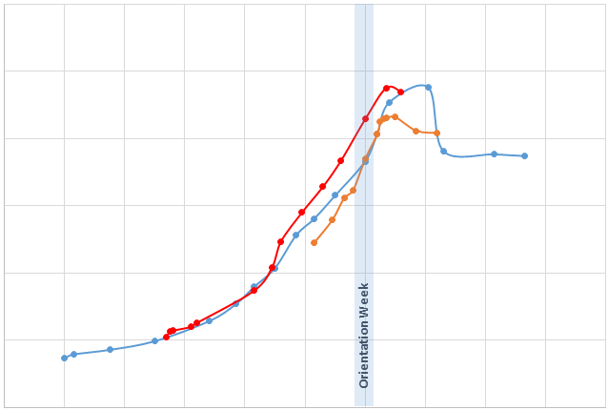
Enrolment data
^{(CRICOS) #00212K}

Slide 4
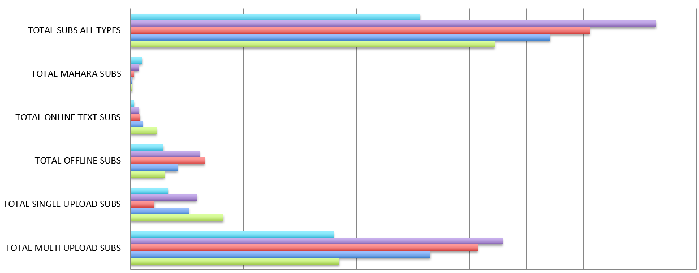
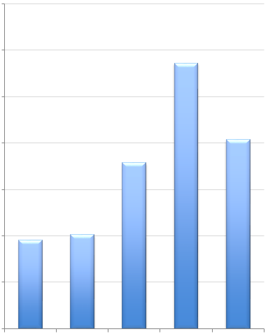
Configurable Reports
^{(CRICOS) #00212K}

Slide 5
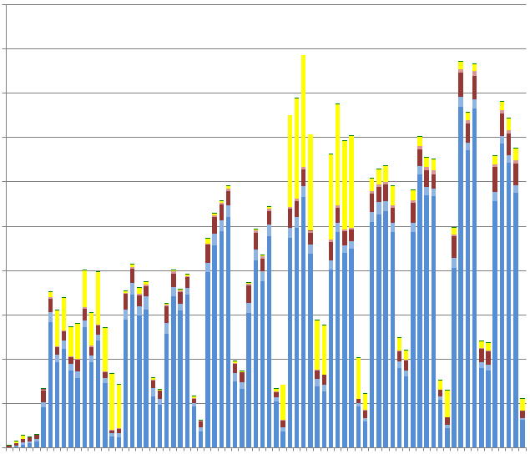
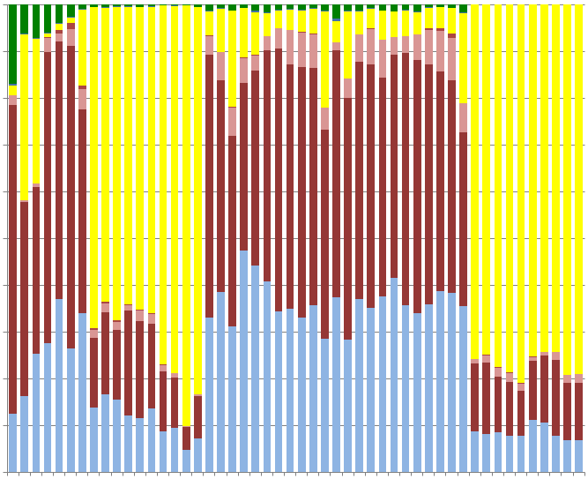
Moodle Statistics
^{(CRICOS) #00212K}

Slide 6
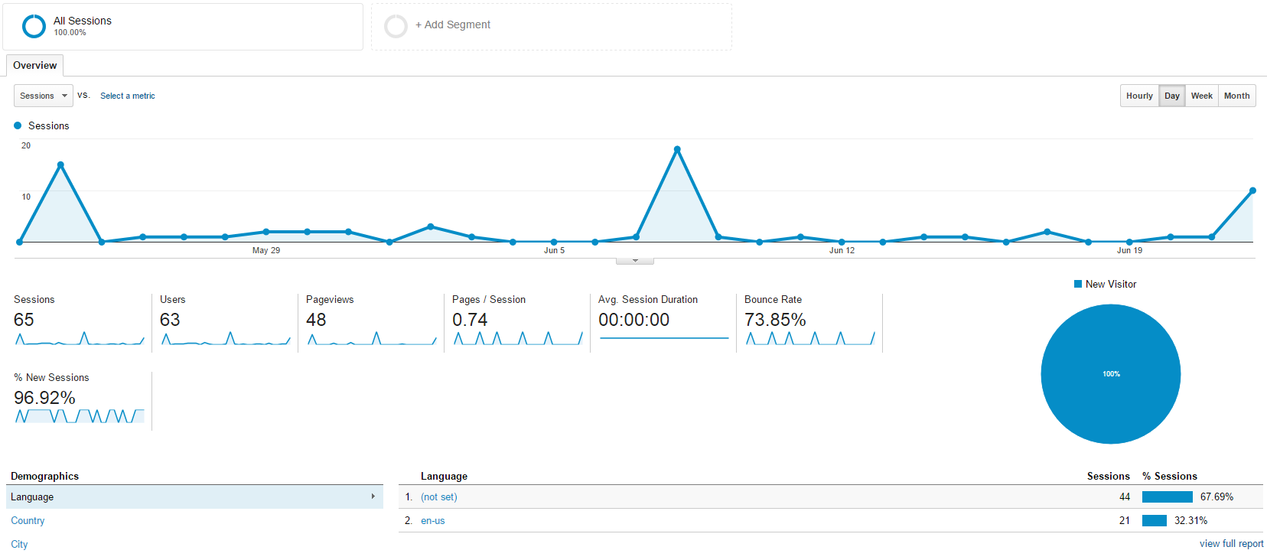
Google Analytics

Slide 7
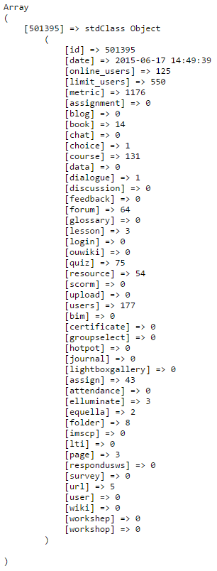
Usage Monitor
Third Party Plug-in
Receives data every 10 Mins
Amazon web-services
6 years worth of data
^{(CRICOS) #00212K}

Slide 8
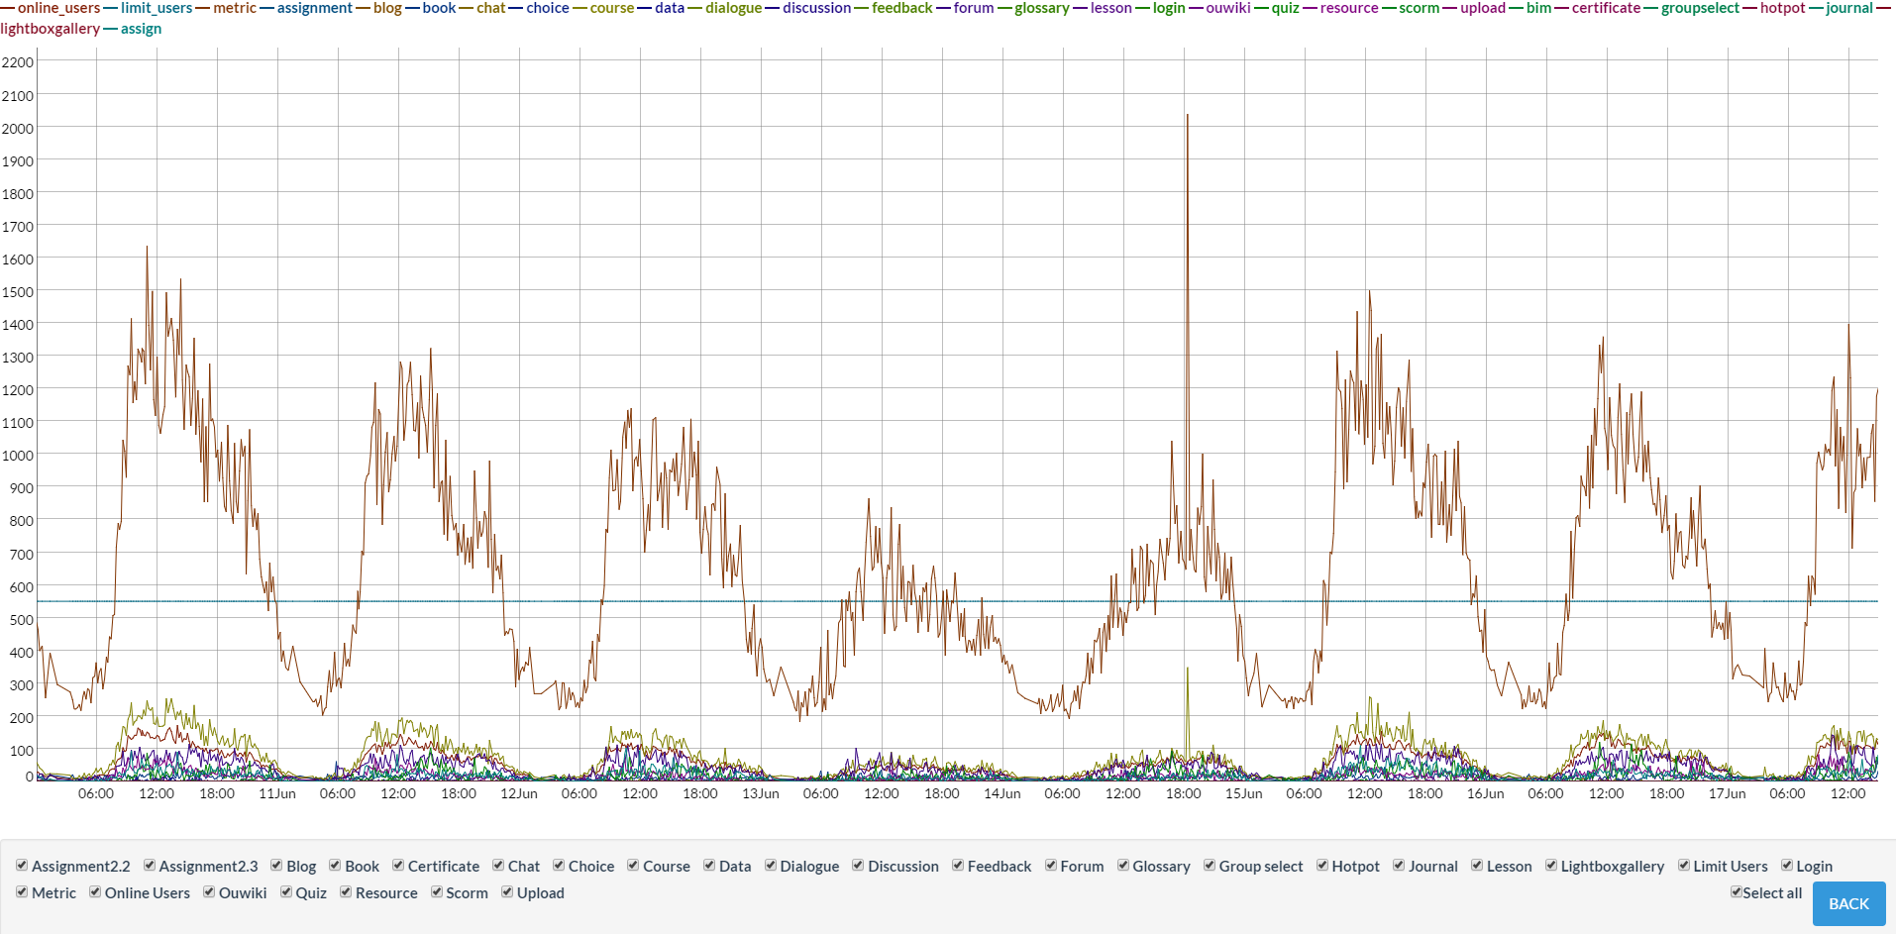
Load Meter
URL: http://54.252.214.80/dashboard
Video1: http://screencast.com/t/Xo5ipX4SsCTd
Video2: http://screencast.com/t/FCy5JXKG

Slide 9
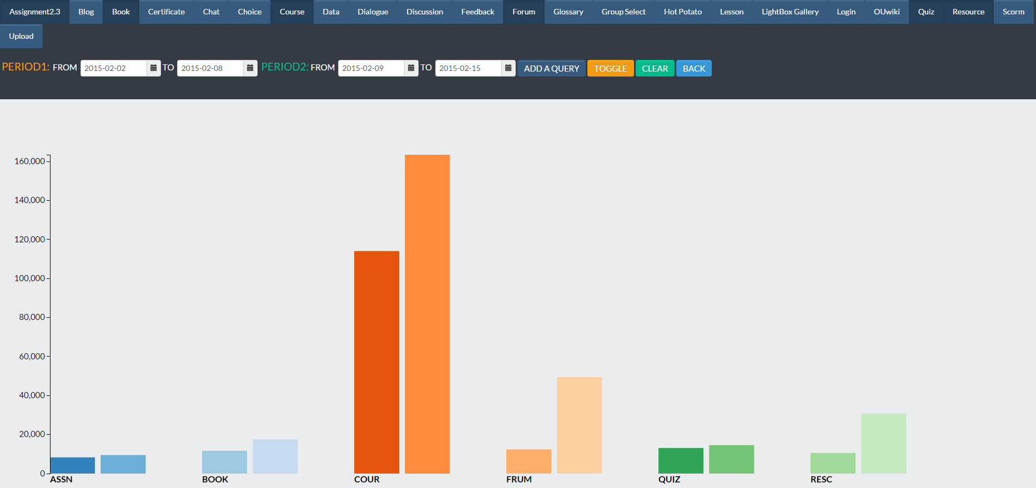
Histogram

Slide 10
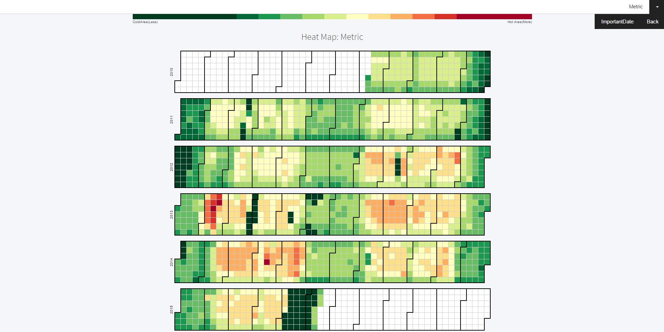
Heat Map

